Slide 1
Exception
PRESENTED BY
HASNAT ZAMIL
ID: 221902001
KHONDOKAR SAIM
ID: 221902353
CSE-201
PRESENTED TO:
Md. Parvez Hossain
Dept. of CSE

Slide 2
What is Exception?
an unwanted or unexpected even
occurs during the execution of a program
runtime errors

Slide 3
Types of error
Runtime Errors
Logic Errors
Compile time Errors

Slide 4
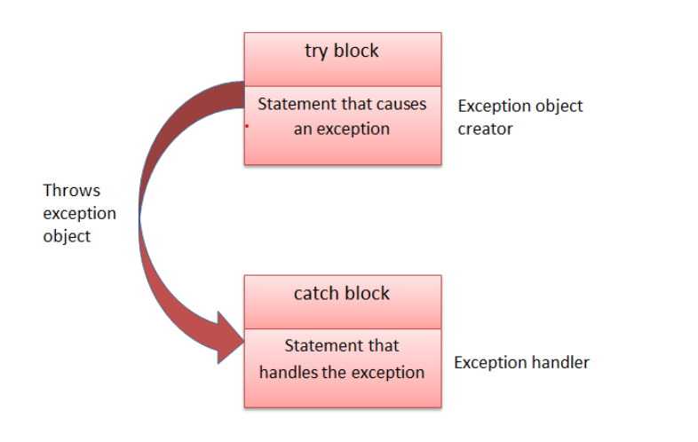
Exceptions
How do you handle exceptions?
  The try-catch is the simplest method of handling exceptions.

Slide 5
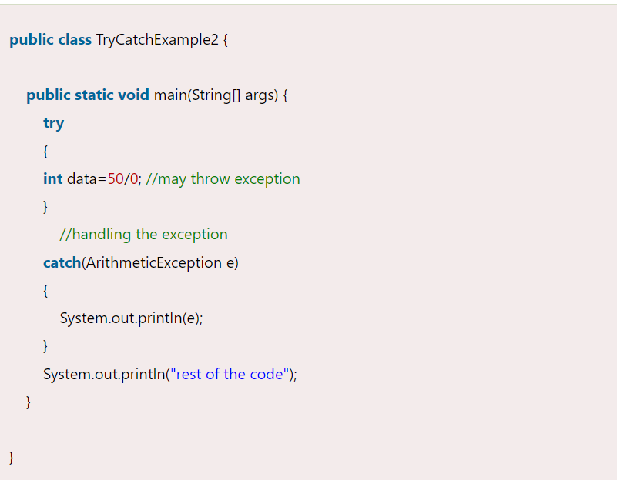
Try-Catch Example

Slide 6
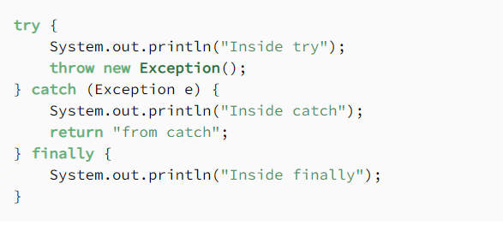
Finally Block
It forced the the code to execute

Slide 7
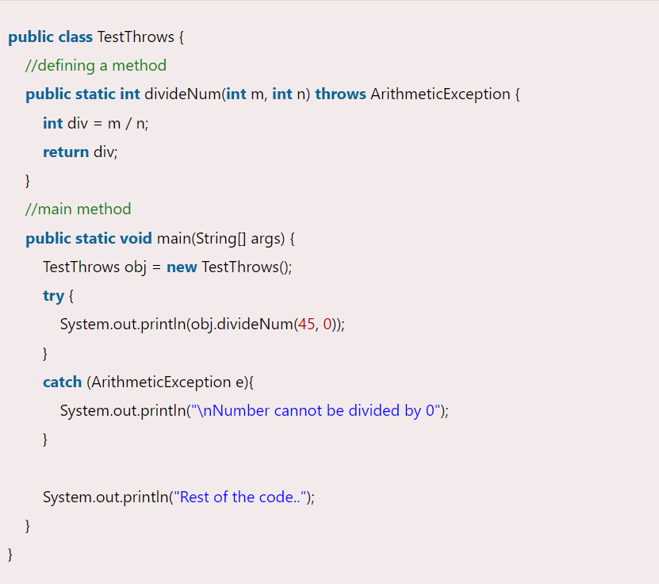
Throw and Throws keyword
Throw block is use to write user define exception
Throws block is used to pass the exception

Slide 8
Thank you

